Slide 1
Software for DHTC Part 2: Interpreted Languages
Christina Koch (ckoch5@wisc.edu)
Research Computing Facilitator
University of Wisconsin - Madison

Slide 2
Recap
Previous techniques:
Compiled code
Download compiled binaries
Build yourself
Wrapper script
Run compiled code
Use a pre-built installation ← we’re going to explore this further in this session

Slide 3
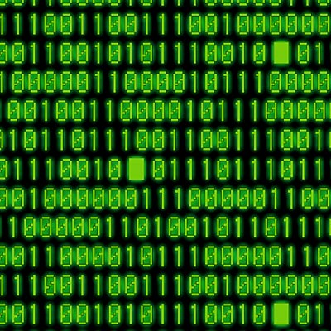

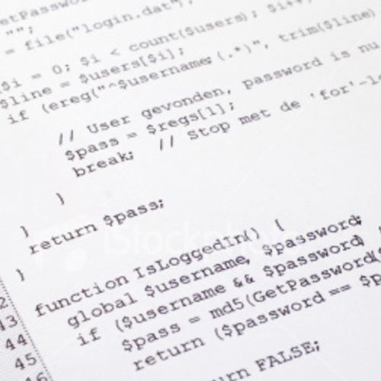


Interpreted code
Instead of being compiled and then run…
…interpreted languages are translated into binary code “on the fly”

Slide 4

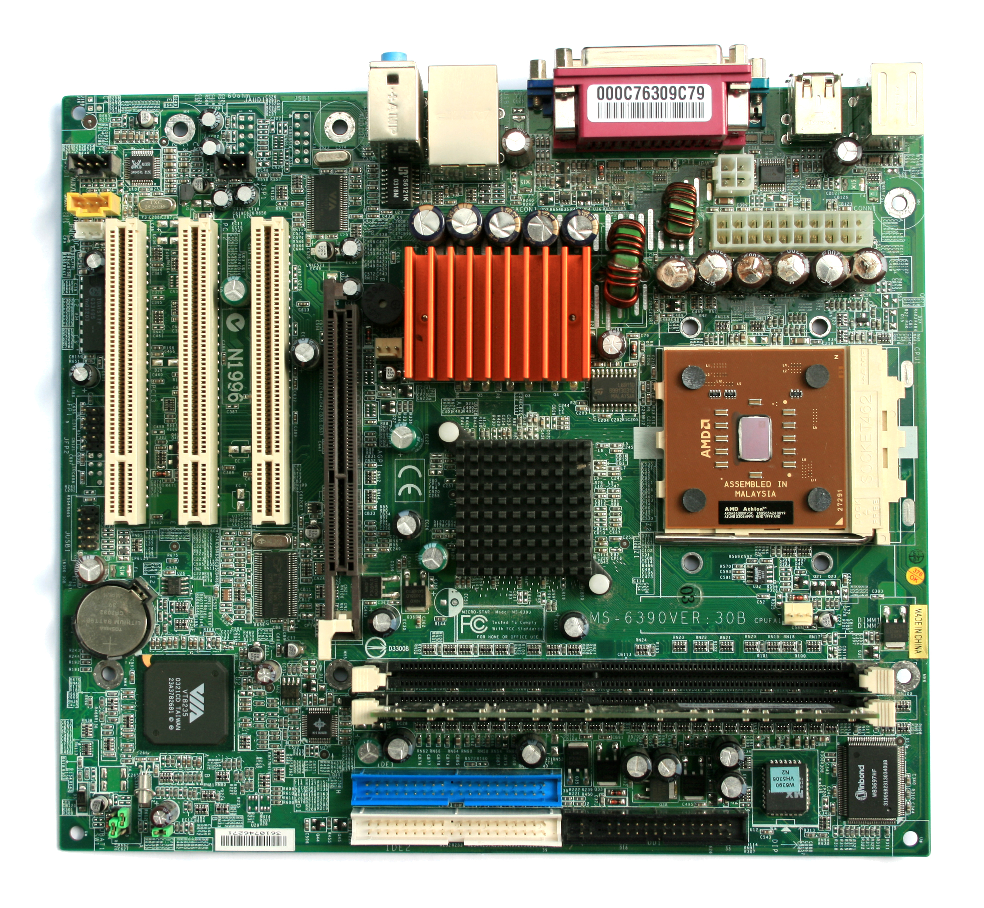
Interpretation
Script
Interpreter
text turns
into binary
instructions
uses
Libraries

Slide 5
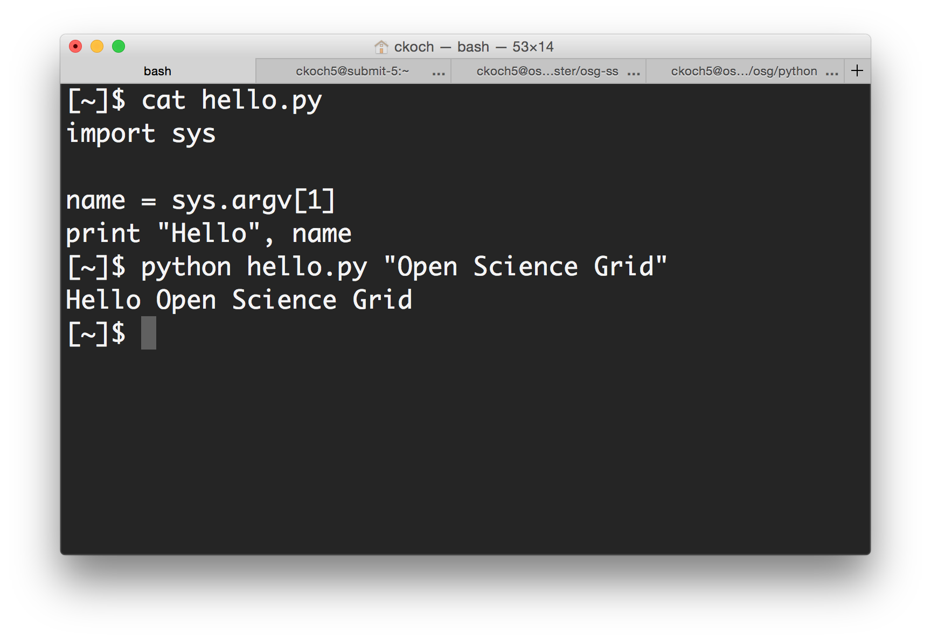
On the command line

Slide 6
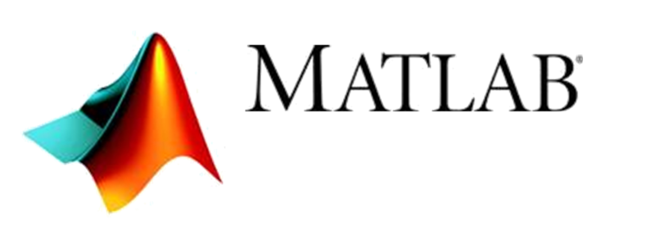


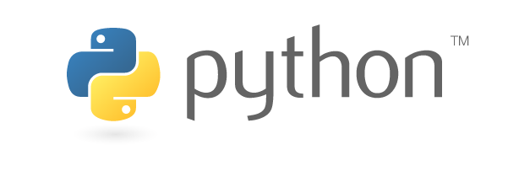

Common interpreted languages*
Python
R
Julia
Ruby
Matlab
Perl
Javascript
*Note: the line between interpreted/compiled languages can be fuzzy. Many languages support both options, with one method being more common.

Slide 7
Running interpreted code in jobs
General procedure
Need to bring along interpreter and script
Use a wrapper script as the executable
Wrapper script will:
“Install” the interpreter
Run the script using the local installation

Slide 8
Python on DHTC
Create a portable Python installation (optional)
Bring along:
pre-built installation OR Python source code
your Python code
Use a wrapper script to:
unpack pre-built install OR install from source
run your Python script
(Similar to Exercise 1.4 this morning, will also work for R)

Slide 9
Exercises
Running Python Jobs
Exercise 4.1: Pre-building Python and using that installation
Exercise 4.2 (optional): Further Python job customizations
Work on other exercises from today/yesterday that you weren’t able to finish

Slide 10
Questions?
Now: Hands-on Exercises
3:45 - 5:00pm

